Slide 1
Front End Engineering-I Project
Team Details
SIMAR _2410993399
SATYAM_2410993396
DHAWAL_2410993333
Faculty Coordinator: Pavan Ambulkar
Chitkara University Institute of Engineering and Technology,
Chitkara University, Punjab

Slide 2
Table of Contents
Introduction
Problem Statement
Technical Details
Key Features
Project Highlights
Conclusion
References/Links used

Slide 3
Introduction
RECIPE SHARING PLATFORM
Team details:
SIMAR
SATYAM CHABRA
DHAWAL GOYAL
We want to build a vibrant community where foodies can interact with one another, exchange and discover new recipes, and customise their culinary adventures on our recipe-sharing website. With user engagement and tailored recommendations, we hope to make meal planning easier and ignite a passion for cooking.

Slide 4
Problem Statement
We want to build a vibrant community where foodies can interact with one another, exchange and discover new recipes, and customise their culinary adventures on our recipe-sharing website. With user engagement and tailored recommendations, we hope to make meal planning easier and ignite a passion for cooking. Our recipe-sharing website seeks to solve the following major issues that culinary aficionados encounter:
Recipe Sources: Dispersed over multiple websites, blogs, and social media platforms, many individuals find it difficult to locate trustworthy and varied recipes . It is challenging to find and effectively arrange recipes because of this fragmentation.
Lack of Personalisation : Current platforms frequently fall short in offering tailored advice based on unique dietary requirements, tastes, and culinary prowess . Meal preparation and planning may become less fun and more labour intensive as a result.
Community Engagement: To facilitate the sharing of culinary experiences, feedback, and mutual learning, a more engaged and encouraging community is required . Strong community features that encourage participation and interaction are frequently absent from current platforms. By resolving these problems, our platforms aims to create a comprehensive, user-friendly, and engaging space for all food lovers.

Slide 5


Technical Details
LANGUAGES USED
DEPLOYEMENT AND HOSTING
Netlify is used to deploy the website as it free of cost , easy to use and reliable.

Slide 6
Key Features
Upload Recipes
Access Recipes Uploaded by other Users
View Recipes by Our partenerd Chefs

Slide 7
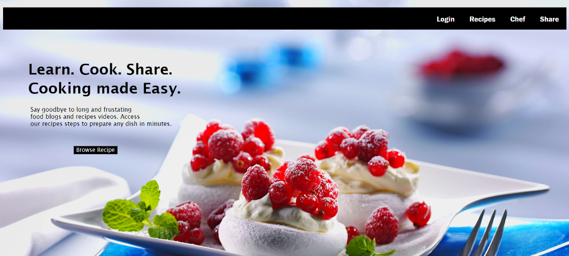
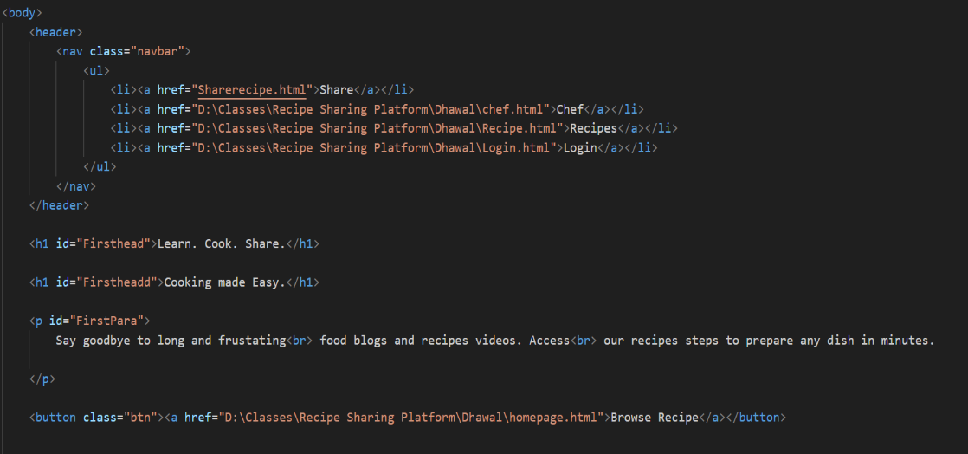
Project Highlights

Slide 8
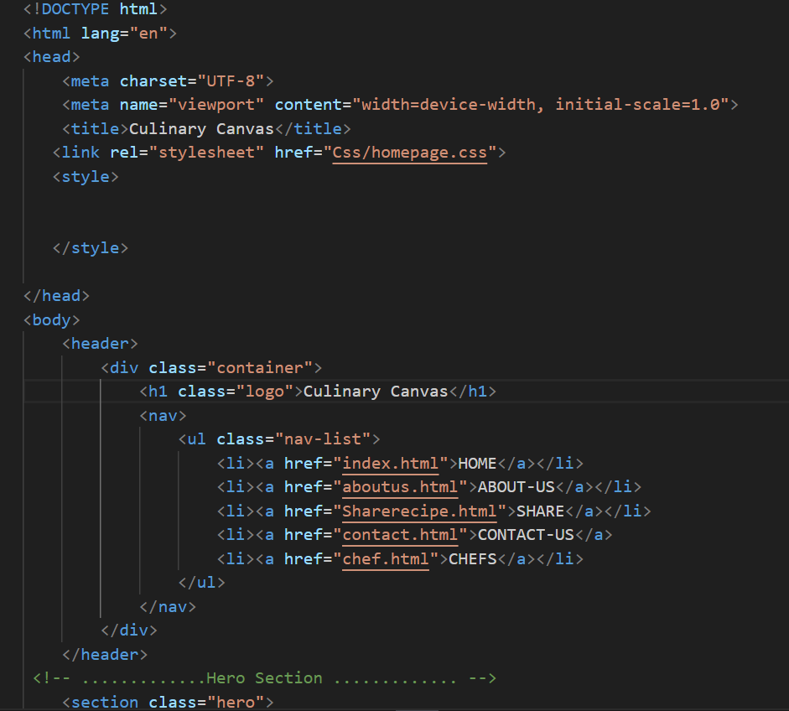
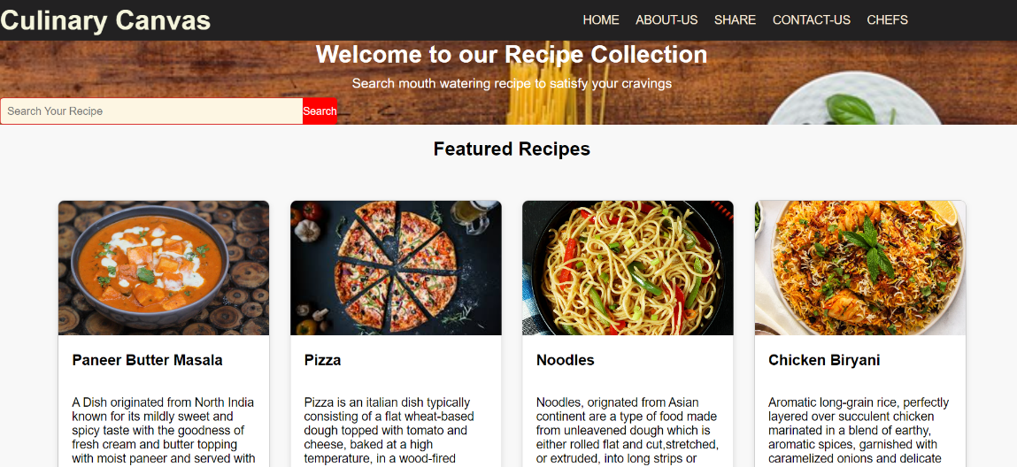
Project Highlights

Slide 9
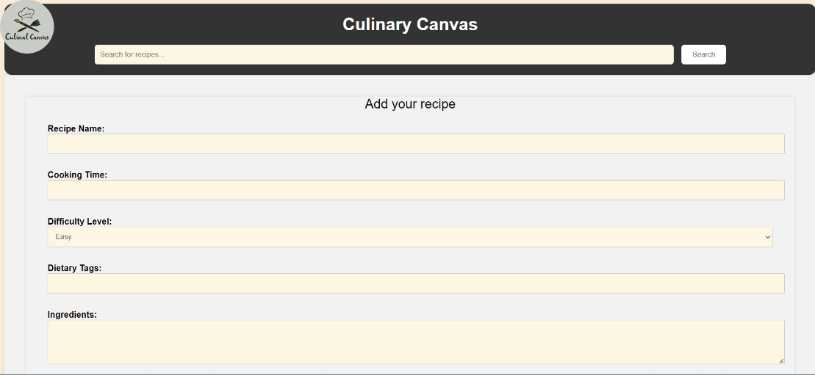
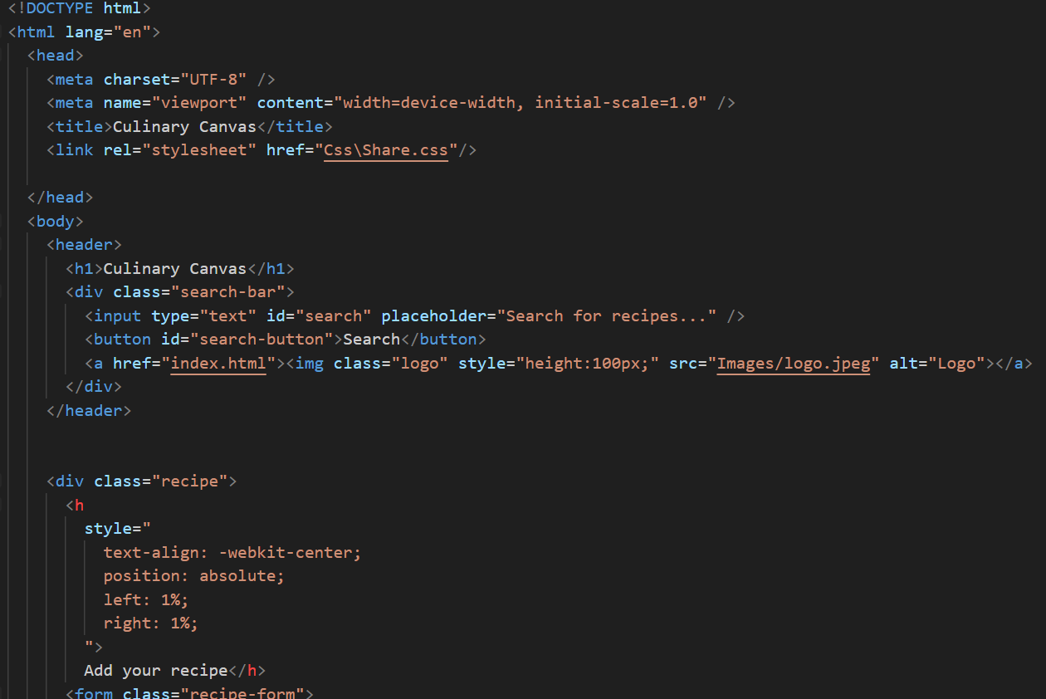
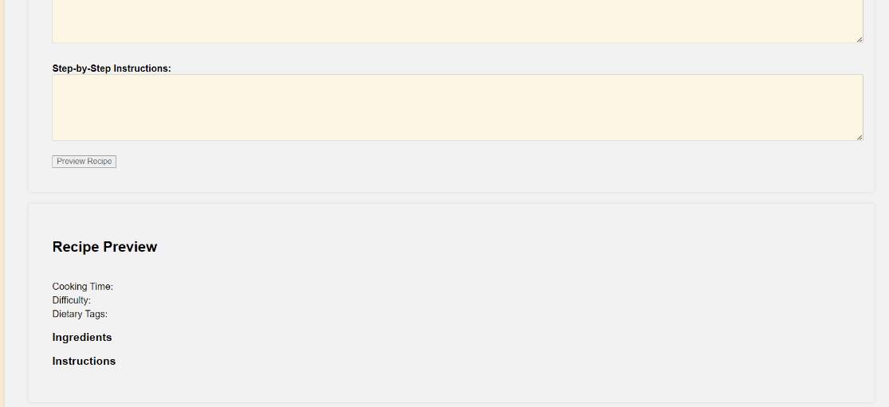
Project Highlights

Slide 10
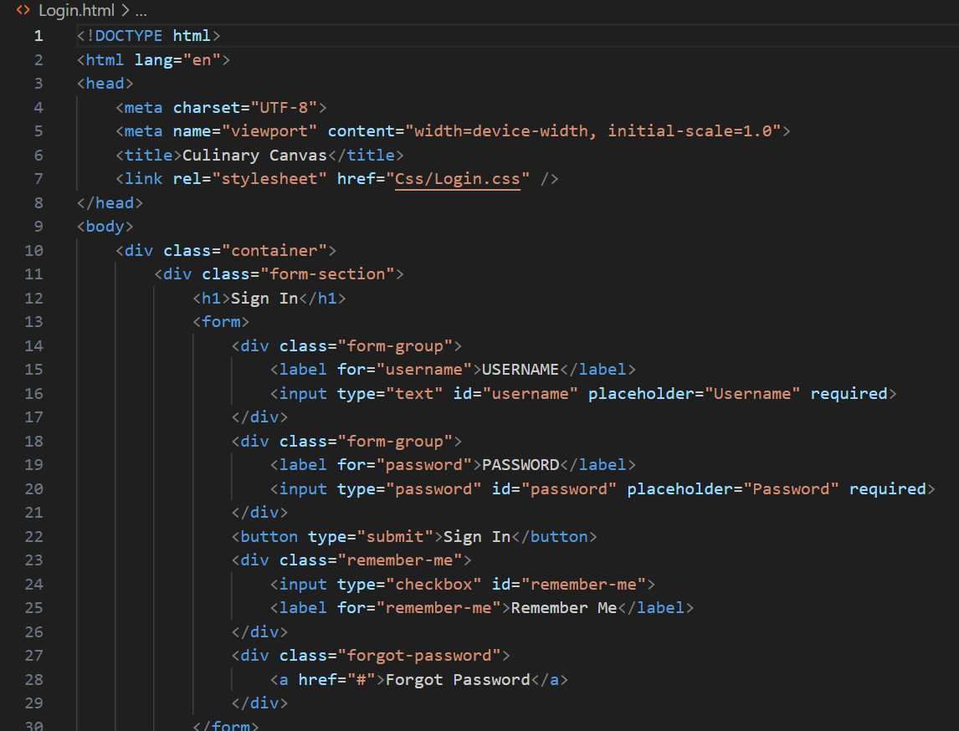
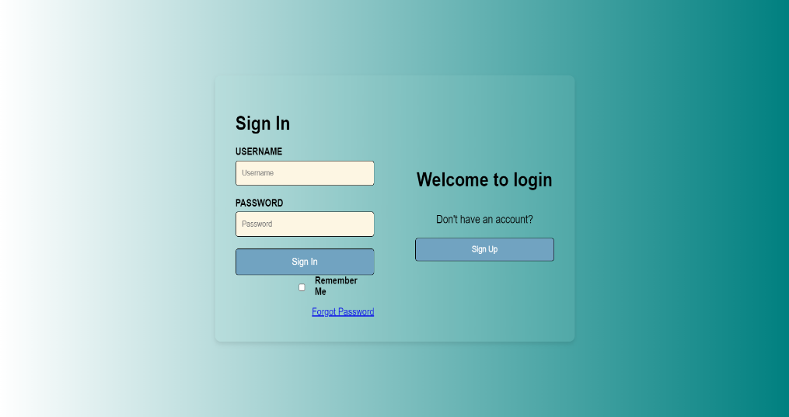
Project Highlights

Slide 11
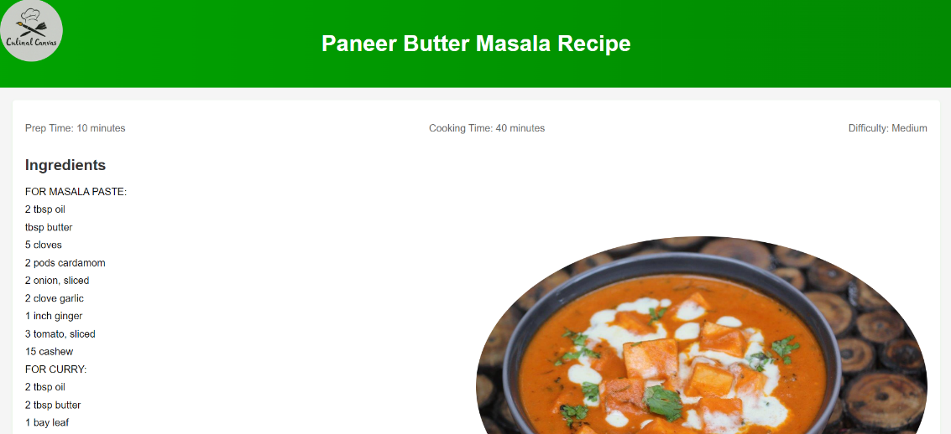
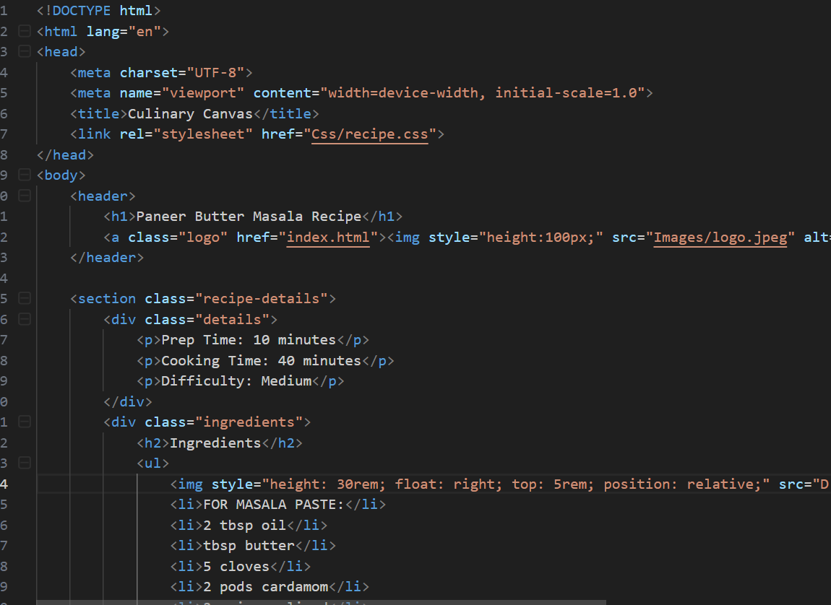
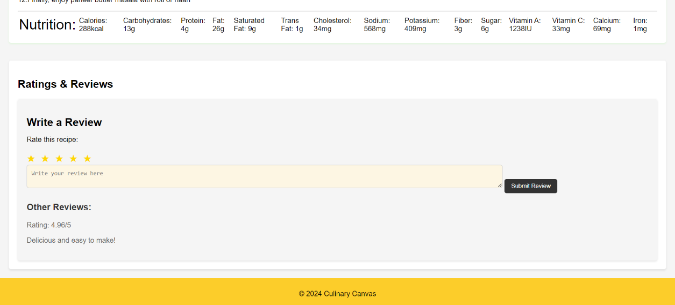
Project Highlights

Slide 12
Conclusion
Our recipe-sharing website project successfully addresses the need for a centralized and engaging platform for food enthusiasts. By leveraging modern technologies we have created a dynamic space where users can share and discover diverse recipes, interact with a supportive community, and enjoy a culinary experience.
Key Points:
Purpose and Goals: To create a vibrant community for sharing and discovering recipes, simplifying meal planning, and fostering a love for cooking.
Problem Solved: Addressed the fragmentation of recipe sources and need for community engagement.
Technologies Used: Utilized a robust tech stack including html , css for authentication.
Team’s Main Takeaways:
Collaboration and Innovation: Working together as a team allowed us to combine our diverse skills and ideas, leading to innovative solutions and a successful project.
User-Centric Design: Focusing on user needs and feedback was crucial in creating a platform that is both functional and enjoyable to use.
Continuous Learning: The project provided valuable learning experiences in modern web development technologies and best practices, which will benefit us in future endeavors.
Overall, this project has been a rewarding journey, and we are excited about the positive impact our platform will have on the culinary community.

Slide 13
References/Links used
References used to craft this website:
MDN Docs
W3 schools
Youtube

Slide 14


